Slide 1
Automated Machine Learning (AutoML) in Insurance
Aug. 4, 2022
Presenter: Panyi Dong

Slide 2
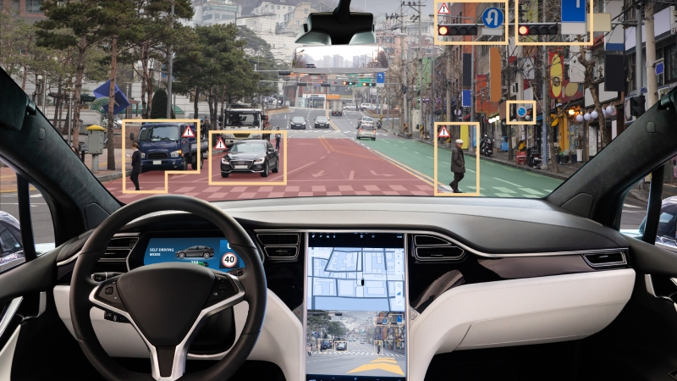
1. Introduction to AutoML
Machine learning (ML) is a field of Artificial Intelligence (AI) and a field of inquiry devoted to understanding and building methods that 'learn', that is, methods that leverage data to improve performance on some set of tasks. [1]
Common application scenarios:
(1) Self Driving Cars
(2) Recommending Systems
(3) Automated Translation
(4) ….
For Insurance:
(1) Predict future claim frequency/severity
(2) Fraud prevention
(3) …
Fig. Self-Driving Cars [2]

Slide 3
1. Introduction to AutoML
However, ML tasks can be experience-dependent and heavy manual work.
Given the nature of ML algorithms, which are data-driven, selection of models and hyperparameters are critical for each dataset, and no universal solution exists.
Furthermore, industrial datasets usually are not well-formatted or well-organized, and problems like missing values, irrelevant features, imbalance distributions exists.
It’s difficult for those who have no previous experience/knowledge to gain hands-on experience.

Slide 4
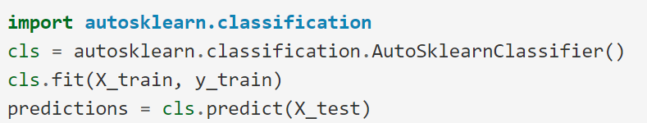
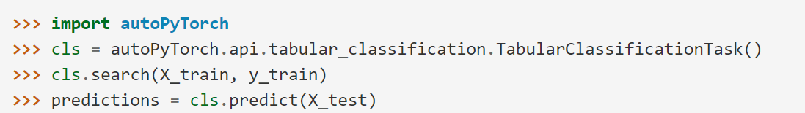
1. Introduction to AutoML
Automated Machine Learning (AutoML) is one of the solutions.
AutoML tries to automatically select a ML model and tuning for optimal hyperparameters, so that “non-expert users” can apply ML to their application scenarios more effectively and “achieve improved performance”. [3]
Fig. auto-sklearn [5]
Fig. AutoGluon [4]
Fig. Auto-PyTorch [ 6]

Slide 5
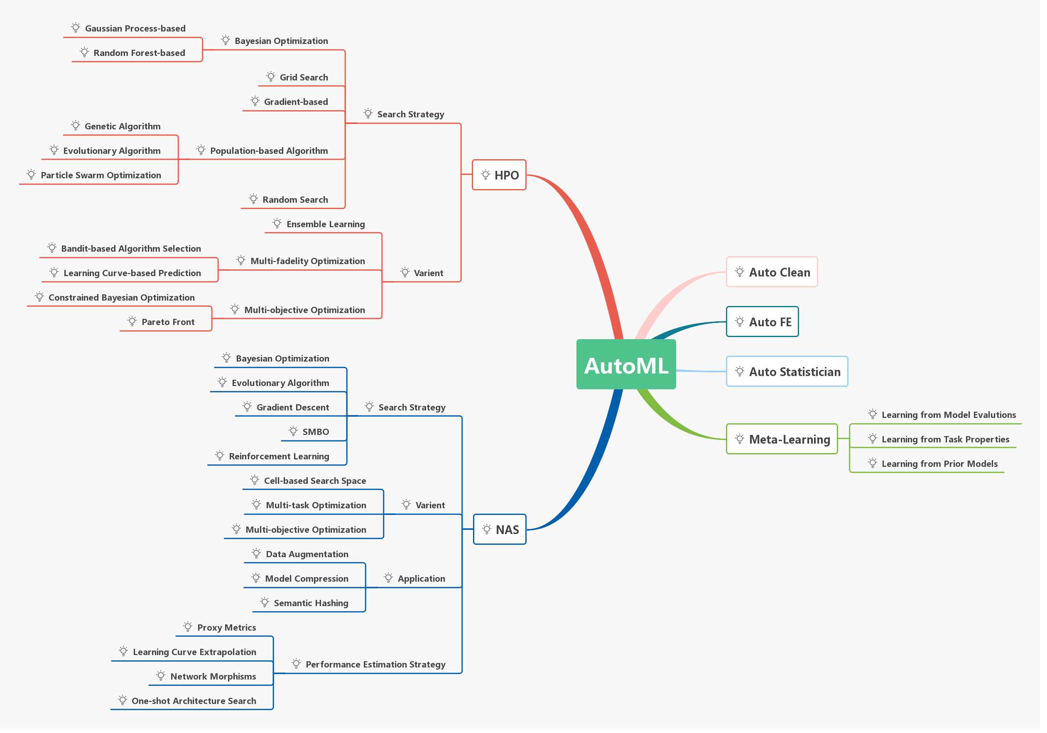
Fig. AutoML research mainstream [7]

Slide 6
1. Introduction to AutoML
Key criteria of AutoML:
(1) Better Performance
What’s a proper search space; How the model/hyperparameter evaluated;
Better model search algorithms, hyperparameter optimization algorithms; …
(2) Higher Efficiency
AutoML usually evaluate by training multiple models, how to more efficiently assess
(or sometimes with limited computation resources)
(3) Ease of use, Robustness
The goal is to ease expertise required, a robust AutoML for all possible scenarios

Slide 7
1. Introduction to AutoML
Our AutoML pipeline:
(1) Complete, fully functional processing and model tuning
Special treatment for imbalanced datasets
Record training process and store the optimal pipeline for continued applications

Slide 8
2. Components & Pipline
Data Encoding
Data Imputation
Data Balancing
Data Scaling
Feature Selection
Classification/Regression Models
Model Selection and Hyperparameter Optimization
Preprocessing

Slide 9
2. Components & Pipeline
Preprocessing & Models
Hyperparameter Search Space
No
Whether budget depleted
Tabular Data
Sample Model & Hyperparameter setting
Preprocessing
Model Training
Tasks per evaluation
Training Records
Optimal Settings
Fig. Our AutoML pipeline workflow
Trained Pipeline

Slide 10
2.1. Data Encoding
Real-life datasets sometimes contain features of string type.
Convert unique strings to numerical types
One-hot encoding
Majority of common ML methods in Python does not support string as inputs, encoding becomes necessary.

Slide 11
2.2. Data Imputation
Some of datasets contains missing values where true values can not be traced.
Causes: Incomplete data entry, Save malfunction, …
Common solutions:
(1) Delete missing values.
Advantage: all remaining values are true values.
Drawback: not feasible when data size is small.
(2) Impute the missing values with estimated values.
Advantage: best utilize all available information.
Drawback: imputed values may not accurately describe the missing values, time-consuming, …

Slide 12
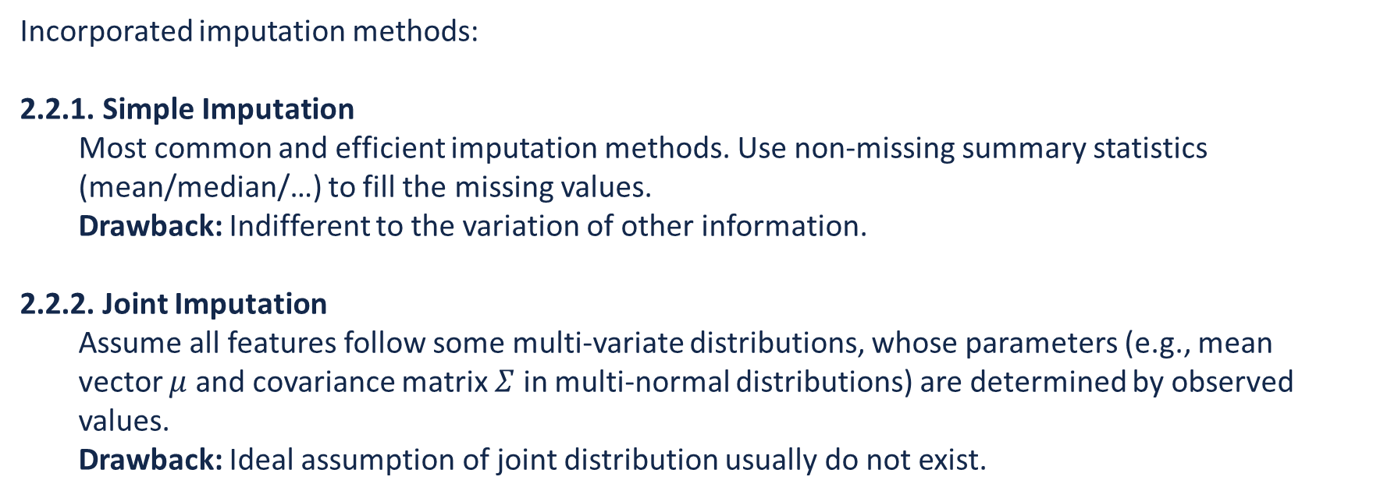
2.2. Data Imputation
Incorporated imputation methods:
2.2.1. Simple Imputation
Most common and efficient imputation methods. Use non-missing summary statistics (mean/median/…) to fill the missing values.
Drawback: Indifferent to the variation of other information.
2.2.2. Joint Imputation
Assume all features follow some multi-variate distributions, whose parameters (e.g., mean vector $μ$ and covariance matrix $Σ$ in multi-normal distributions) are determined by observed values.
Drawback: Ideal assumption of joint distribution usually do not exist.

Slide 13
2.2. Data Imputation
Incorporated imputation methods:
2.2.3. Expectation Maximization (EM) [8]
Utilize the classical EM algorithm, where the E step tries to create a function of log-likelihood, and M step tries to maximize the likelihood.
Drawback: underestimate standard error of imputed values.
2.2.4. KNN Imputation [9]
2.2.5. Miss Forest Imputation [9]
2.2.4, 2.2.5 builds corresponding models (k Nearest Neighbors for 2.2.4 and Random Forest for 2.2.5) on observed values and predictions as imputation values.

Slide 14
2.2. Data Imputation
Incorporated imputation methods:
2.2.6. Multiple Imputation by Chained Equations (MICE) [10]
One of most popular Multiple Imputation methods, multiple copies datasets are created and each missing values are filled with multiple cycles of predictions of model fitted.
Drawback: Time-consuming for not small datasets to converge.
2.2.7. Generative Adversarial Imputation Nets (GAIN) [11]
Utilize the Generative Adversarial Network (GAN) to train a Generator (G) and Discriminator (D) where G tries to generate values for missing positions and D tries to distinguish whether the generated values are valid.
Drawback: Large data size required for neural network training, and time-consuming.

Slide 15
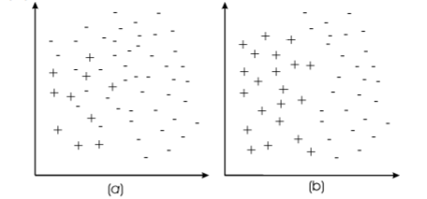
2.3. Data Balancing
Some of datasets exhibits imbalanced nature where majority values are the same
(e.g., 99% of policyholders do not report claims).
Traditional ML models evaluated by classical metrics may not
be the ideal solution by the business perspective.
Common solutions:
(1) Increase the weights of minority class.
(2) Over-sampling on minority class/Down-sampling on majority class. [12]
(3) Create a model ensemble (multiple models weighted on prediction).
(4) Special loss metrics for gradient-based models.
(5) …
Fig. Spatial illustration of unbalanced datasets (a) and balanced datasets (b). [12]

Slide 16
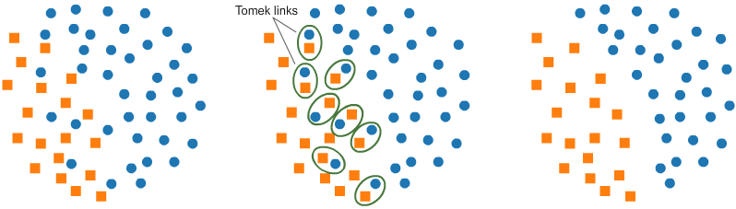
2.3. Data Balancing
Incorporated balancing methods:
(focusing on over-sampling/down-sampling at this step)
2.3.1. Simple Random Over-Sampling
2.3.2. Simple Random Down-Sampling
Method 2.3.1 and 2.3.2 simply randomly copy minority class entries/eliminate majority class entries.
2.3.3. Tomek Link [13]
An Under-Sampling method.
Remove noise majority class around decision
boundaries.
Fig. Illustration of Tomek Link [14]

Slide 17
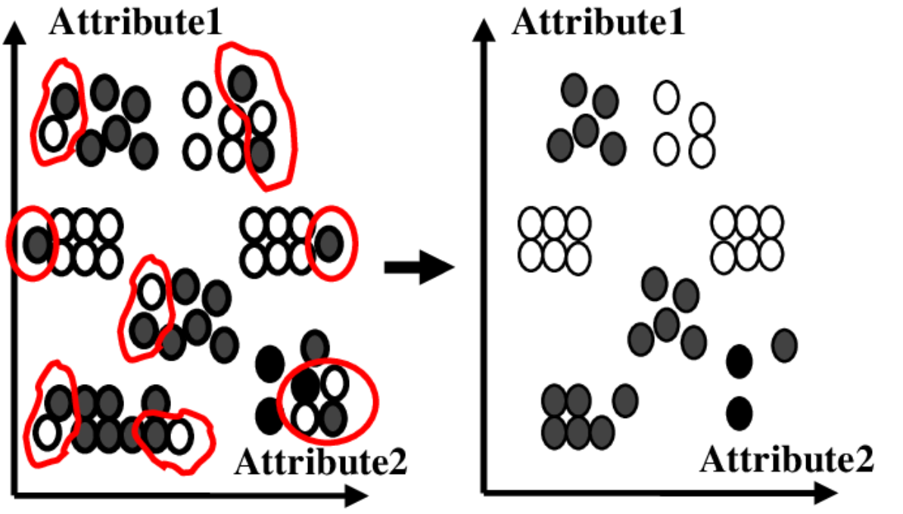
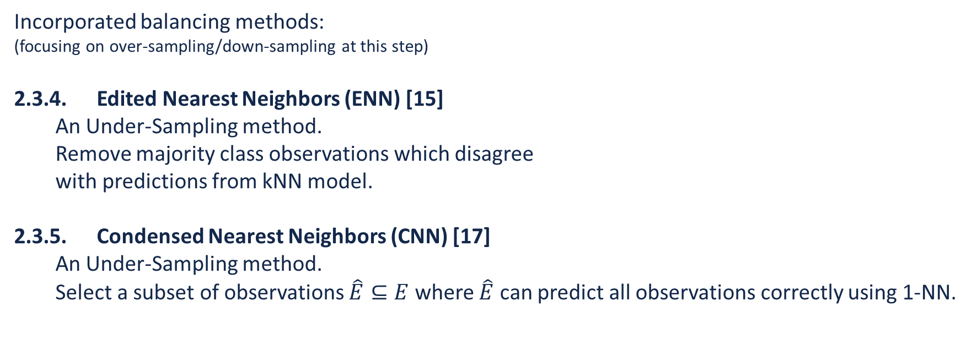
2.3. Data Balancing
Incorporated balancing methods:
(focusing on over-sampling/down-sampling at this step)
2.3.4. Edited Nearest Neighbors (ENN) [15]
An Under-Sampling method.
Remove majority class observations which disagree
with predictions from kNN model.
2.3.5. Condensed Nearest Neighbors (CNN) [17]
An Under-Sampling method.
Select a subset of observations $\hat{E}⊆E$ where $\hat{E}$ can predict all observations correctly using 1-NN.
Fig. Illustration Edited Nearest Neighbor [16]

Slide 18
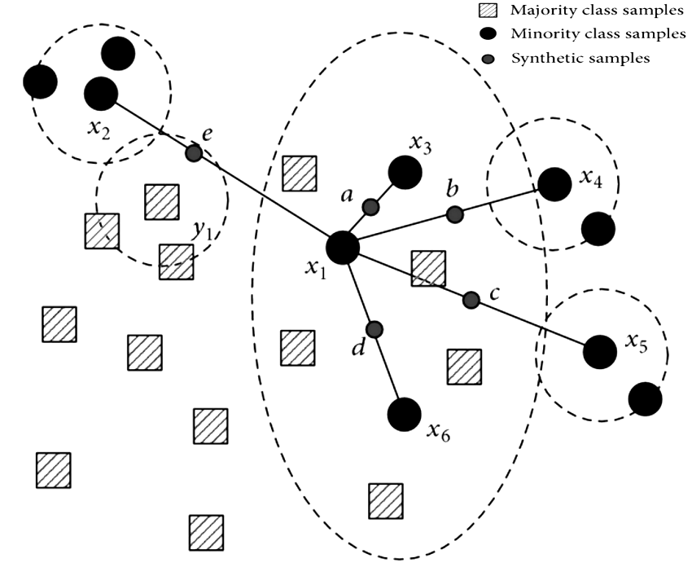
2.3. Data Balancing
Incorporated balancing methods:
(focusing on over-sampling/down-sampling at this step)
2.3.6. Synthetic Minority Over-Sampling Technique (Smote) [18]
A common Over-Sampling method.
Try to generate more realistic synthetic minority observations
by interpolation between minority observations.
2.3.7. One Sided Selection (OSS): Tomek Link + CNN
2.3.8. CNN_Tomek Link: CNN + Tomek Link
2.3.9. Smote_Tomek Link: Smote + Tomek Link
2.3.10. Smote_ENN: Smote + ENN
Combination of two-step balancing methods, take advantages of both steps.
Fig. Illustration of Smote [19]

Slide 19
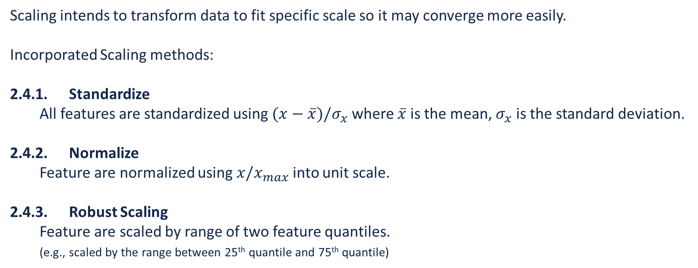
2.4. Data Scaling
Scaling intends to transform data to fit specific scale so it may converge more easily.
Incorporated Scaling methods:
2.4.1. Standardize
All features are standardized using $(x−\overline{x})/σ_{x}$ where $\overline{x}$ is the mean, $σ_{x}$ is the standard deviation.
2.4.2. Normalize
Feature are normalized using $x/x_{max}$ into unit scale.
2.4.3. Robust Scaling
Feature are scaled by range of two feature quantiles.
(e.g., scaled by the range between 25th quantile and 75th quantile)

Slide 20
2.4. Data Scaling
Incorporated Scaling methods:
2.4.4. Min-Max Scaling
Feature are scaled by min/max values to [0,1] range.
2.4.5. Power Transformer
Apply a power transformation (Box-Cox/Yeo-Johnson transformation) to each feature to shape data more normal-distributed.
2.4.6. Winsorization
Cap features at certain quantile to avoid extreme values (outliers).

Slide 21
2.5. Feature Selection
Modern datasets have hundreds of (or even more) features with exploding size.
However, some of them may be reductant or irrelevant, which may decrease the model performance while still takes long training time. One of the solution is using feature selection to select only subset of features for model training.
Common categories of feature selection [20]:
Filter: use statistical analysis in only feature space
Wrapper: train a model on feature subsets and use performance as selection criteria.
Embedded: embed feature importance into model training and use as selection criteria.
Hybrid: combine filter and wrapper for feature selection.

Slide 22
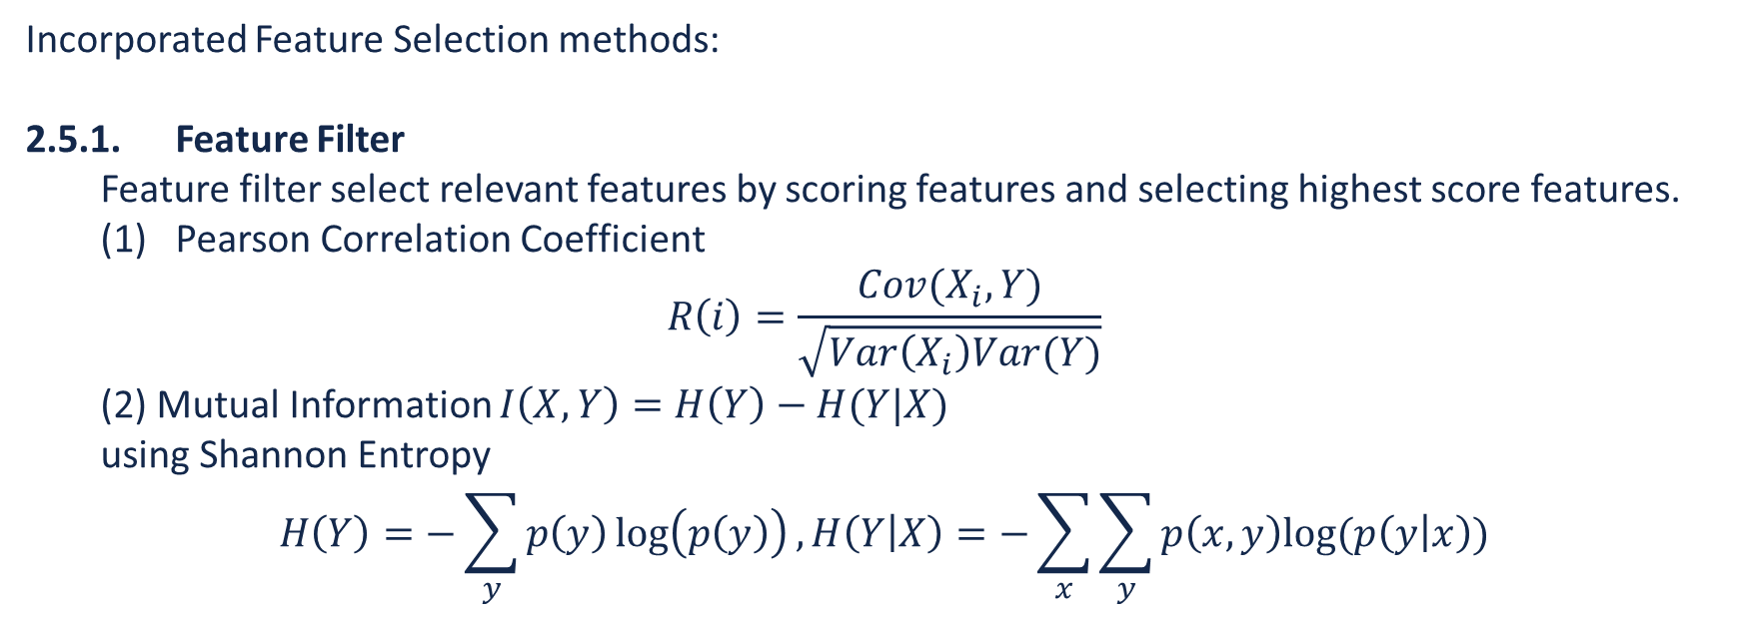
2.5. Feature Selection
Incorporated Feature Selection methods:
2.5.1. Feature Filter
Feature filter select relevant features by scoring features and selecting highest score features.
(1) Pearson Correlation Coefficient
$$R\left(i\right)=\frac{Cov(X_{i}, Y)}{\sqrt{Var\left(X_{i}\right)Var(Y)}}$$
(2) Mutual Information $I\left(X,Y\right)=H\left(Y\right)−H(Y|X)$
using Shannon Entropy
$$H\left(Y\right)=−\sum_{y}{p\left(y\right)\log\left(p\left(y\right)\right)},H\left(Y | X\right)=−\sum_{x}{\sum_{y}{p\left(x,y\right)log⁡(p\left(y | x\right))}}$$

Slide 23
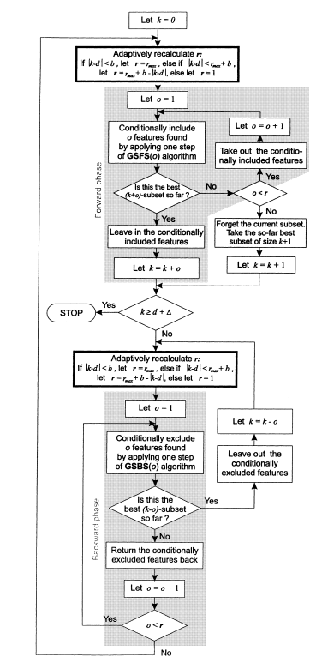
2.5. Feature Selection
Incorporated Feature Selection methods:
2.5.2. Adaptive Sequential Forward Floating Search (ASFFS) [21]
ASFFS is a variation of sequential feature selection (SFS) method
to deal with feature correlation.
ASFFS iteratively performs forward phase and backward until target
reached where forward phase adds features, backward phase
removes features.
ASFFS will adaptively change number of features consider at a time.
Fig. Workflow of ASFFS [12]

Slide 24
2.5. Feature Selection
Incorporated Feature Selection methods:
2.5.3. Genetic Algorithm (GA) [22]
GA is a popular algorithm inspired by natural DNA replication/mutation.
GA consists of selection, crossover and mutation phase at each generation. With generations of offspring, best feature selection rules will be selected.
During the process, all rules are evaluated by fitness function with their performance and assigned a possibility of selection.
0 | 0 | 1 | 1 | 0 | 1
1 | 1 | 0 | 1 | 0 | 0
… | … | … | … | … | …
0 | 1 | 0 | 1 | 1 | 1
Selection: two rules by fitness function
Roulette Wheel Selection
Parent rules
Crossover
Single-Point Crossover
Pool of selection rule
Child rules
Mutation
1 | 1 | 0 | 1 | 0 | 1
0 | 0 | 1 | 1 | 1 | 0
Adding to pool

Slide 25
2.5. Feature Selection
Incorporated Feature Selection methods:
2.5.4. minimal-Redundancy-Maximal-Relevance (mRMR) [23] [24] [25]
mRMR is a filter method, and a variation of SFS to both maximize relevance and minimize redundancy among selected features. Both redundancy and relevance are defined as mutual information.
2.5.5. Copula-based Feature Selection (CBFS) [26] [27]
CBFS is a filter method where the data is described using copulas, which is a popular method to describe multivariate correlation.
Features are scored by mutual information of copula values.

Slide 26
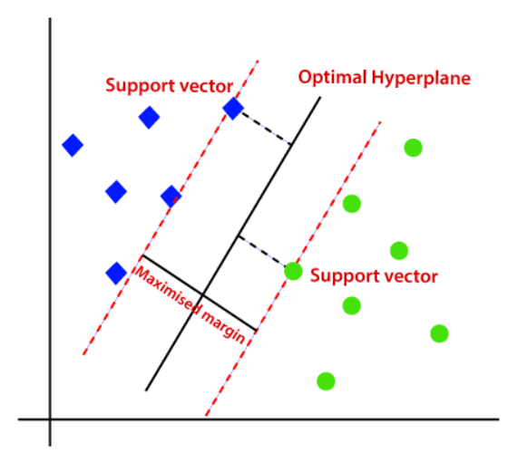
2.6.1. Classification Models
Incorporated Classification models:
2.6.1.1. Logistic Regression
2.6.1.2. Adaboost [28]
2.6.1.3. Hist Gradient Boosting
2.6.1.4. Linear Support Vector Machine (SVM) [30]
2.6.1.5. Kernel Support Vector Machine (SVM) [31]
Fig. Support Vector Machine [32]

Slide 27
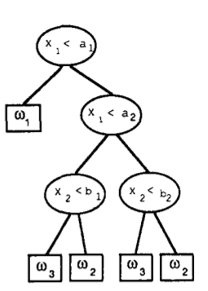
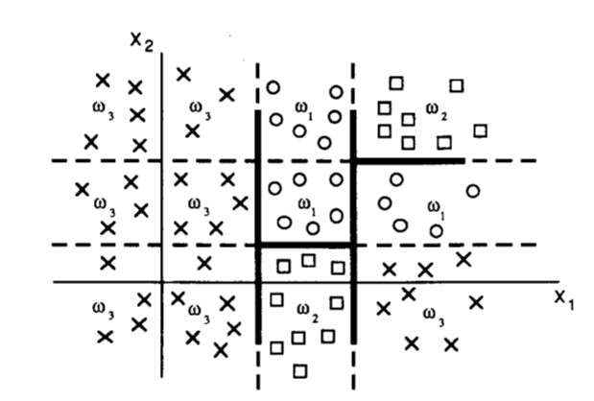
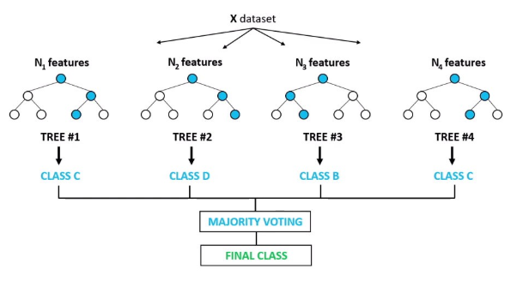
2.6.1. Classification Models
Incorporated Classification models:
2.6.1.6. Decision Tree
2.6.1.7. Extra Trees
2.6.1.8. Random Forest
2.6.1.9. K Nearest Neighbors
2.6.1.10. SGD
Fig. Decision Tree Split [29]
Fig. Split On Data Points [29]
Fig. Random Forest [41]

Slide 28
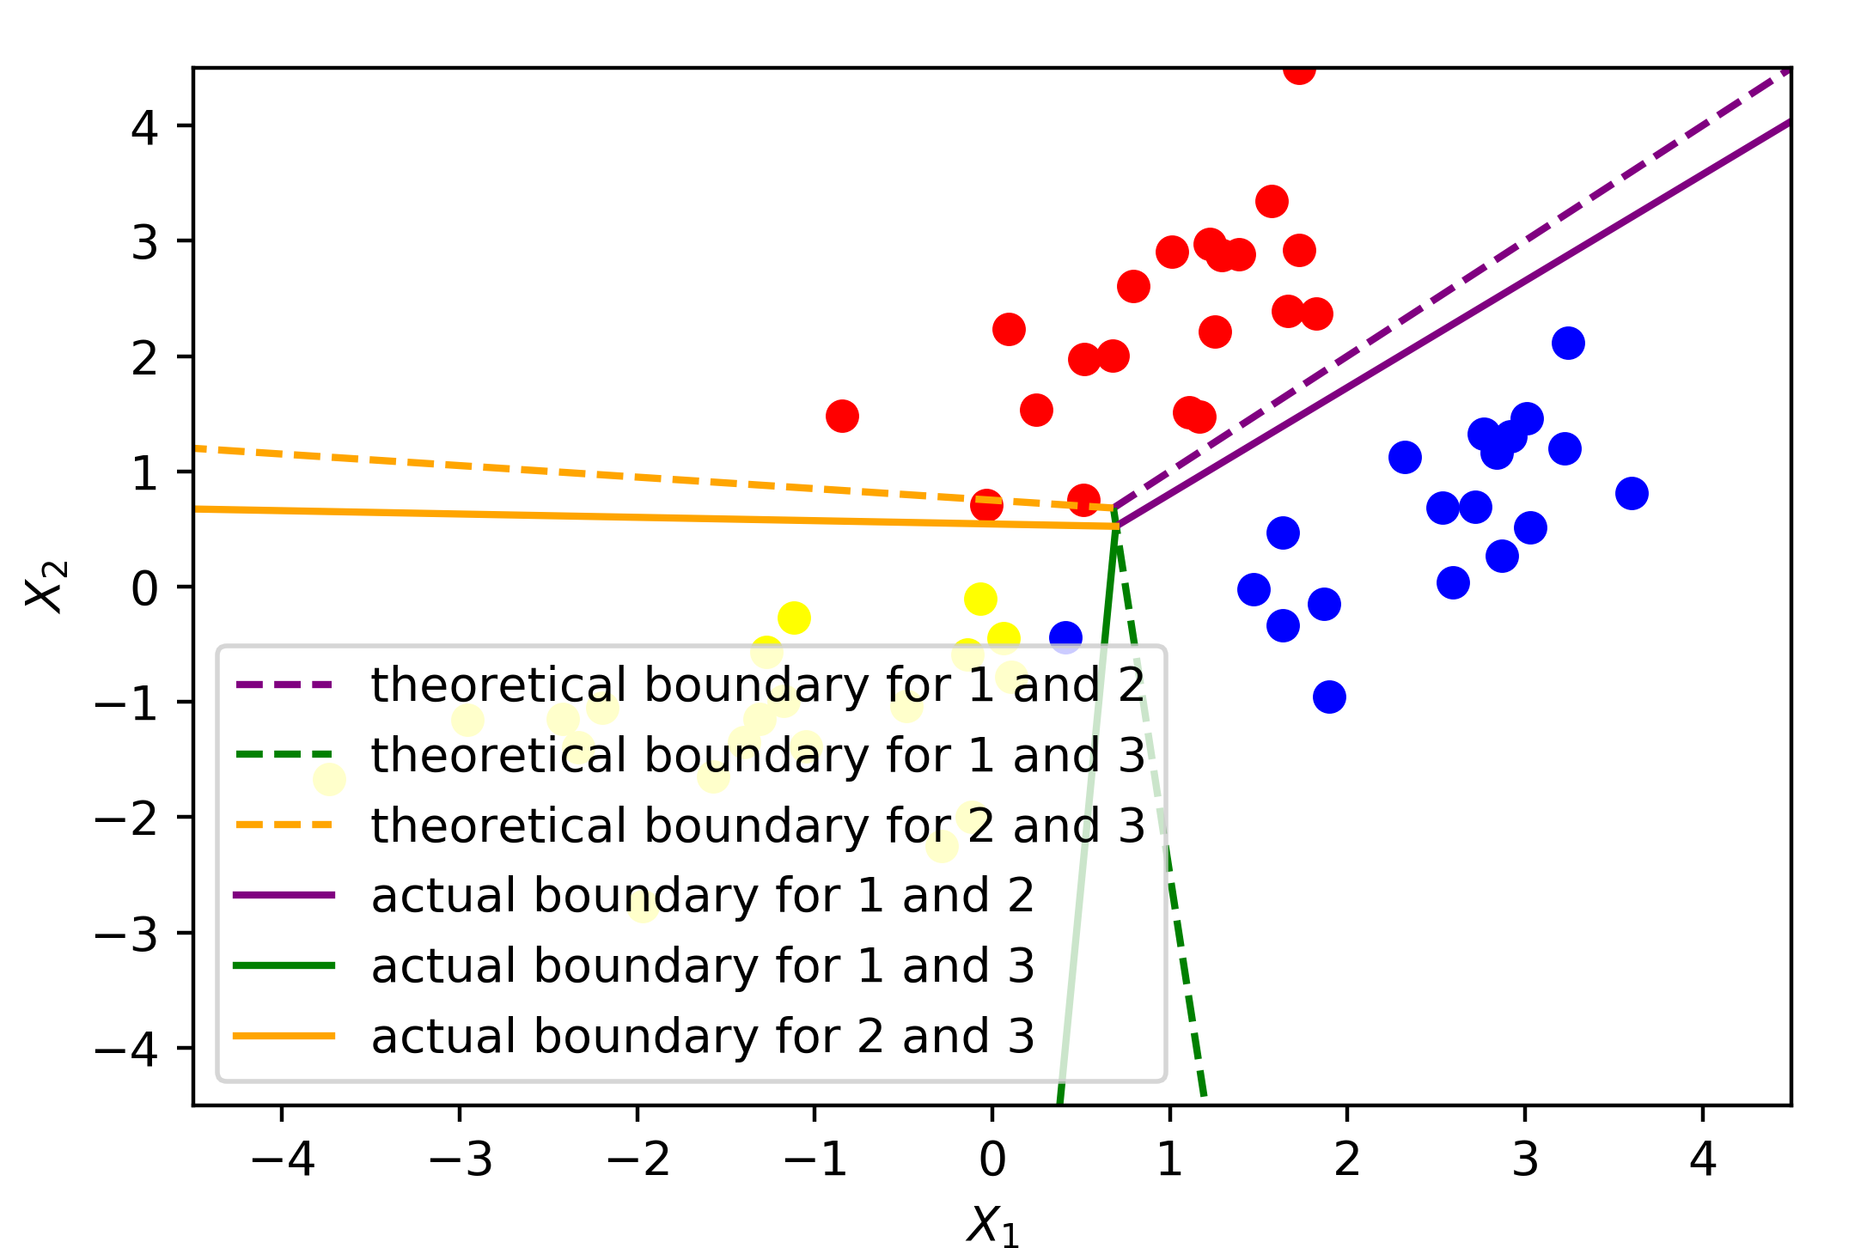
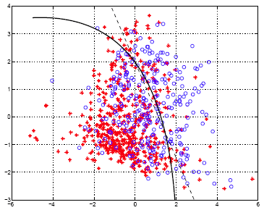
2.6.1. Classification Models
Incorporated Classification models:
2.6.1.11. Linear Discriminant Analysis (LDA)
2.6.1.12. Quadratic Discriminant Analysis (QDA)
2.6.1.13. Bernoulli Naïve Bayes
2.6.1.14. Gaussian Naïve Bayes
2.6.1.15. Multinomial Naïve Bayes
Fig. Linear Discriminant Analysis
Fig. Quadratic Discriminant Analysis [42]

Slide 29
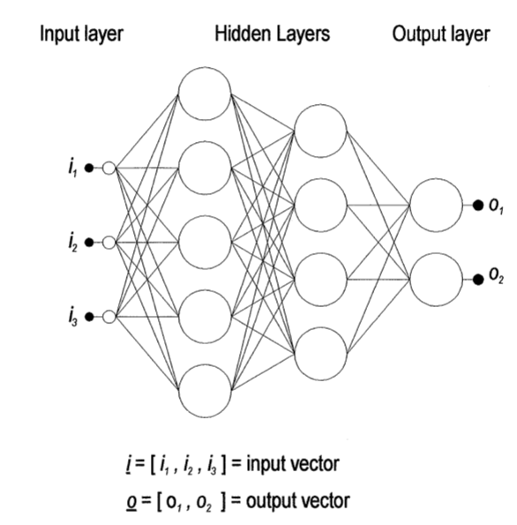
2.6.1. Classification Models
Incorporated Classification models:
2.6.1.16. Multi-Layer Perception (MLP)
2.6.1.17. Passive Aggressive
2.6.1.18. Light Gradient Boosting Machine (LightGBM) [36]
2.6.1.19. Extreme Gradient Boosting (XGBoost) [37]
2.6.1.20. Generalized Additive Models (GAM) [38]
Fig. Multi-Layer Perceptron [33]

Slide 30
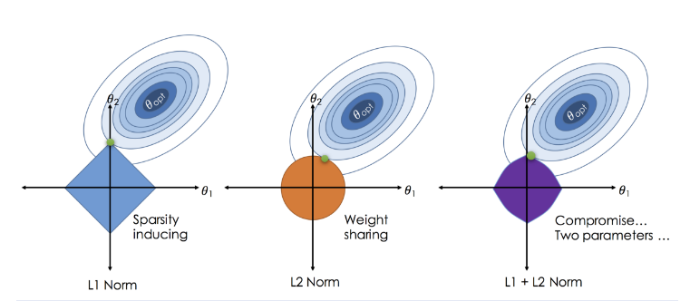
2.6.2. Regression Models
Incorporated Regression models:
2.6.2.1. Linear Regression
2.6.2.2. Lasso Regression
2.6.2.3. Ridge Regression
2.6.2.4. ElasticNet
2.6.2.5. Bayesian Ridge Regression [34]
Fig. ElasticNet [43]

Slide 31
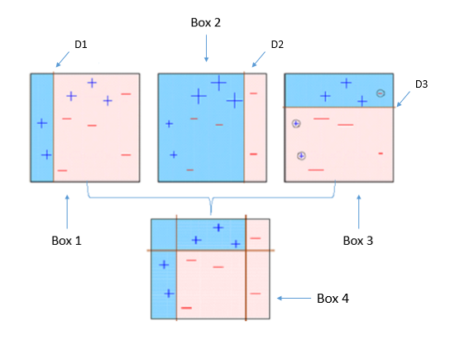
2.6.2. Regression Models
Incorporated Regression models:
2.6.2.6. Adaboost
2.6.2.7. ARD Regression
2.6.2.8. Decision Tree
2.6.2.9. Extra Trees
2.6.2.10. Random Forest
Fig. Adaboost [44]

Slide 32
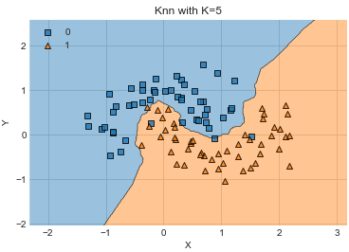
2.6.2. Regression Models
Incorporated Regression models:
2.6.2.11. Gaussian Process [35]
2.6.2.12. Hist Gradient Boosting
2.6.2.13. k Nearest Neighbors
2.6.2.14. Linear Support Vector Machine (SVM)
2.6.2.15. Multi-Layer Perceptron (MLP)
Fig. kNN [45]

Slide 33
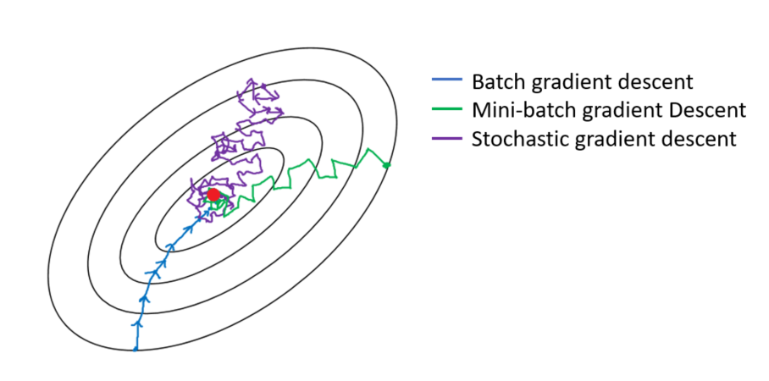
2.6.2. Regression Models
Incorporated Regression models:
2.6.2.16. SGD
2.6.1.17. Light Gradient Boosting Machine (LightGBM) [36]
2.6.1.18. Extreme Gradient Boosting (XGBoost) [37]
2.6.1.19. Generalized Additive Models (GAM) [38]
Fig. Different Gradient Descent [46]

Slide 34
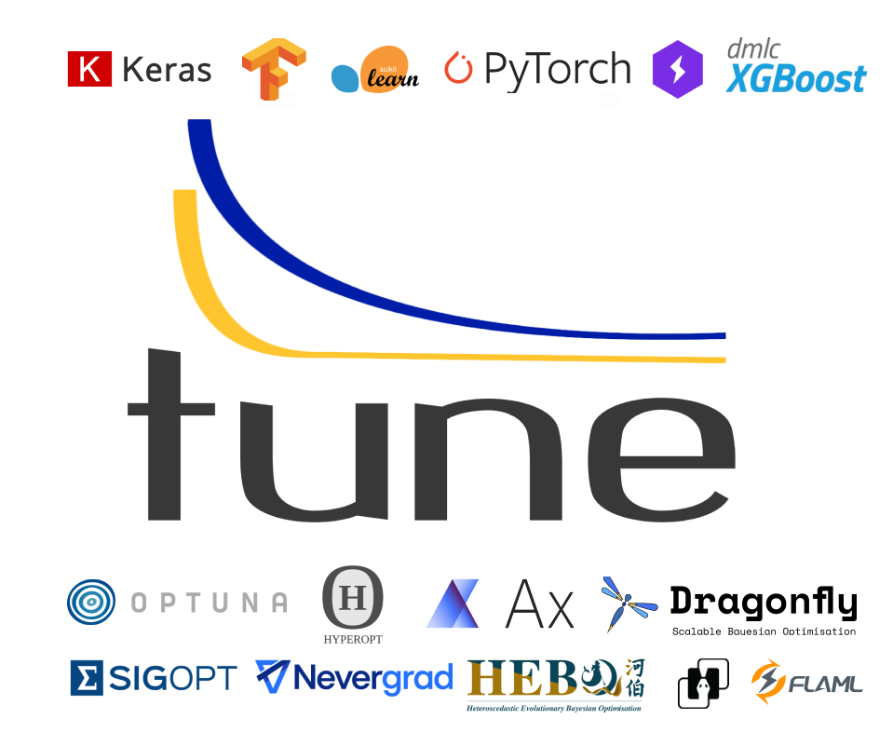
2.7. Model Selection & Hyperparameter Optimization
To connect all preprocessing methods and models with hyperparameter space, we use ray.tune [47] for model selection and hyperparameter optimization.
ray.tune is a scalable Python package to conduct experiments on hyperparameter tuning with all common ML model structures (scikit-learn [39], TensorFlow [48], PyTorch [49], …) with search algorithms like Optuna [50], HyperOpt [51], …

Slide 35
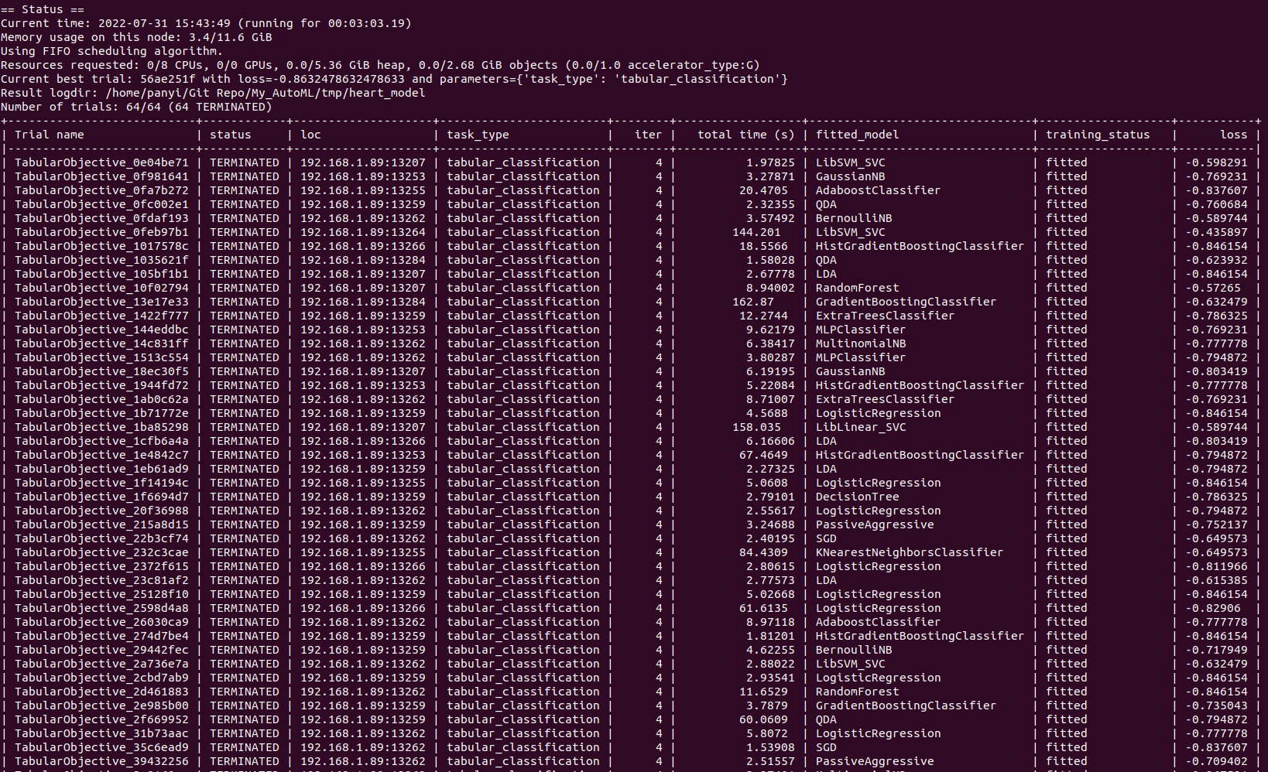
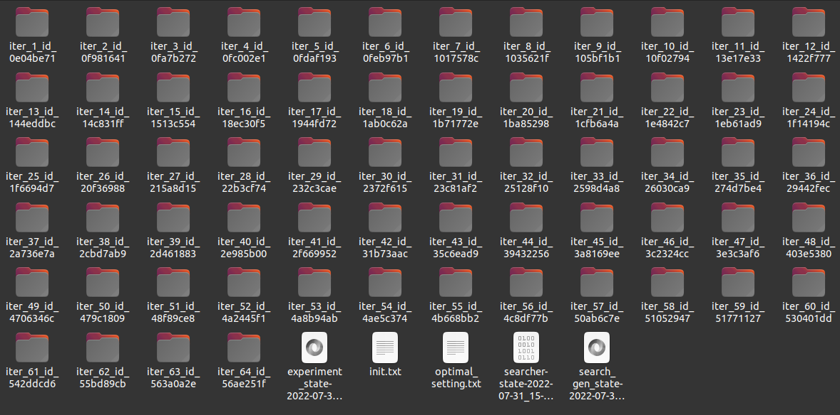
2.7. Model Selection & Hyperparameter Optimization
Fig. Store evaluation experiments
Fig. Report training process

Slide 36
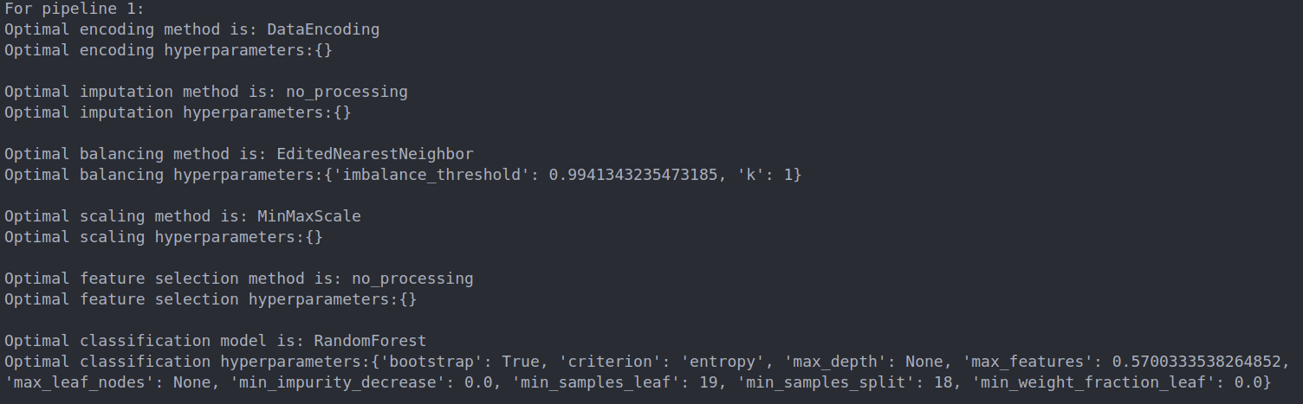
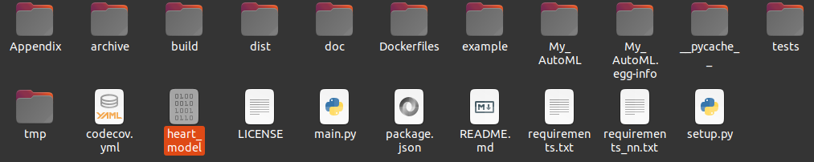
2.7. Model Selection & Hyperparameter Optimization
Fig. Store trained pipelines
Fig. Record optimal setting for checking

Slide 37
2.7.1. Model Ensemble
To fight with data imbalance, model ensemble is another common solution, which is included in the pipeline.
Three commonly-used model ensembles are included:
Stacking
Models are trained parallelly on all train sets, but predictions are weighted as final prediction.
Bagging
Models are trained on subsets of train sets, and weighted predictions as final prediction.
Boosting
Models are trained on error of past models, and all predictions summed as final prediction.

Slide 38
3. Experiments
3.1. Heart Failure Prediction (Classification)
Command line job:
Results (ignore all report process):
Results using 5 pipeline stacking:

Slide 39
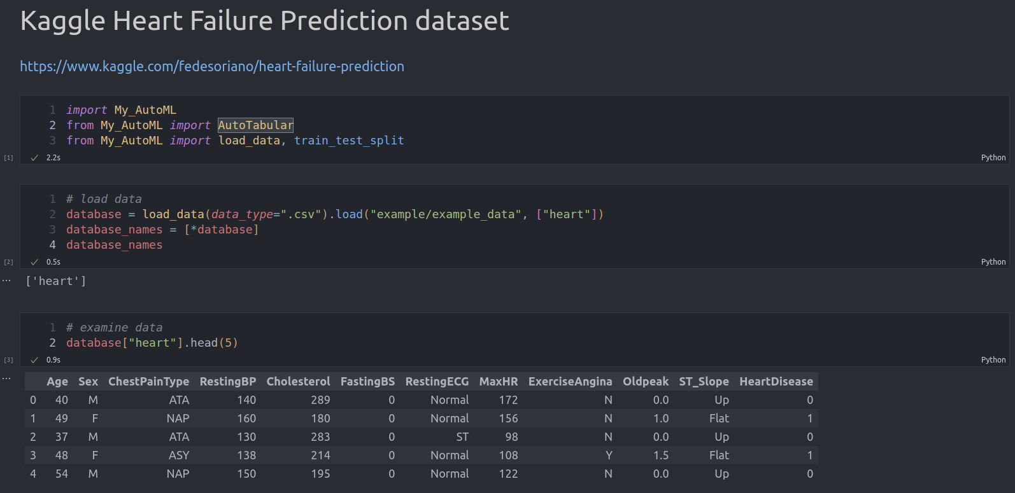
3. Experiments
3.1. Heart Failure Prediction (Classification)
Fig. Load data

Slide 40
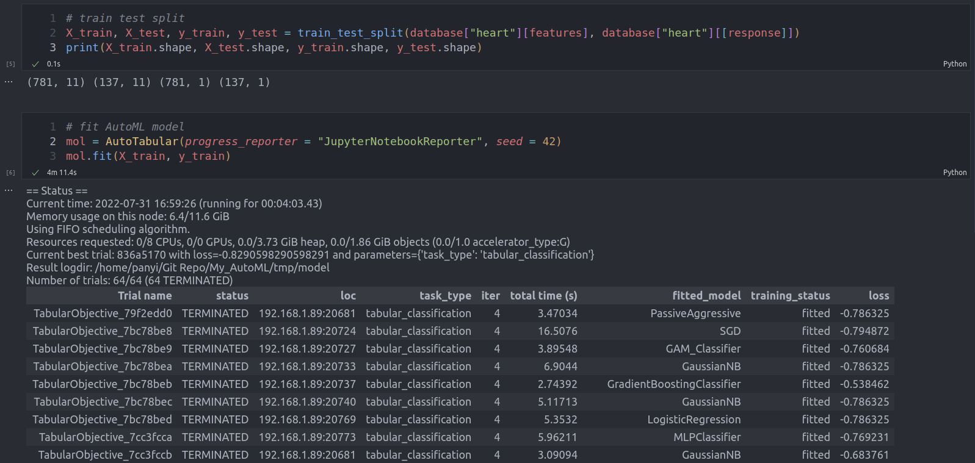
3. Experiments
3.1. Heart Failure Prediction (Classification)
Fig. Train Test split & conduct experiment

Slide 41
3. Experiments
3.1. Heart Failure Prediction (Classification)
Fig. Evaluate Test Performance

Slide 42
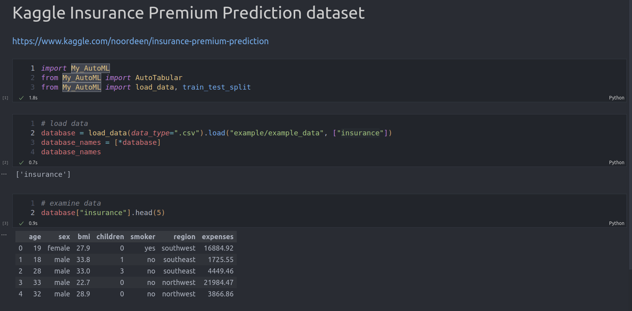
3. Experiments
3.2. Insurance Premium Prediction (Regression)
Fig. Load data

Slide 43
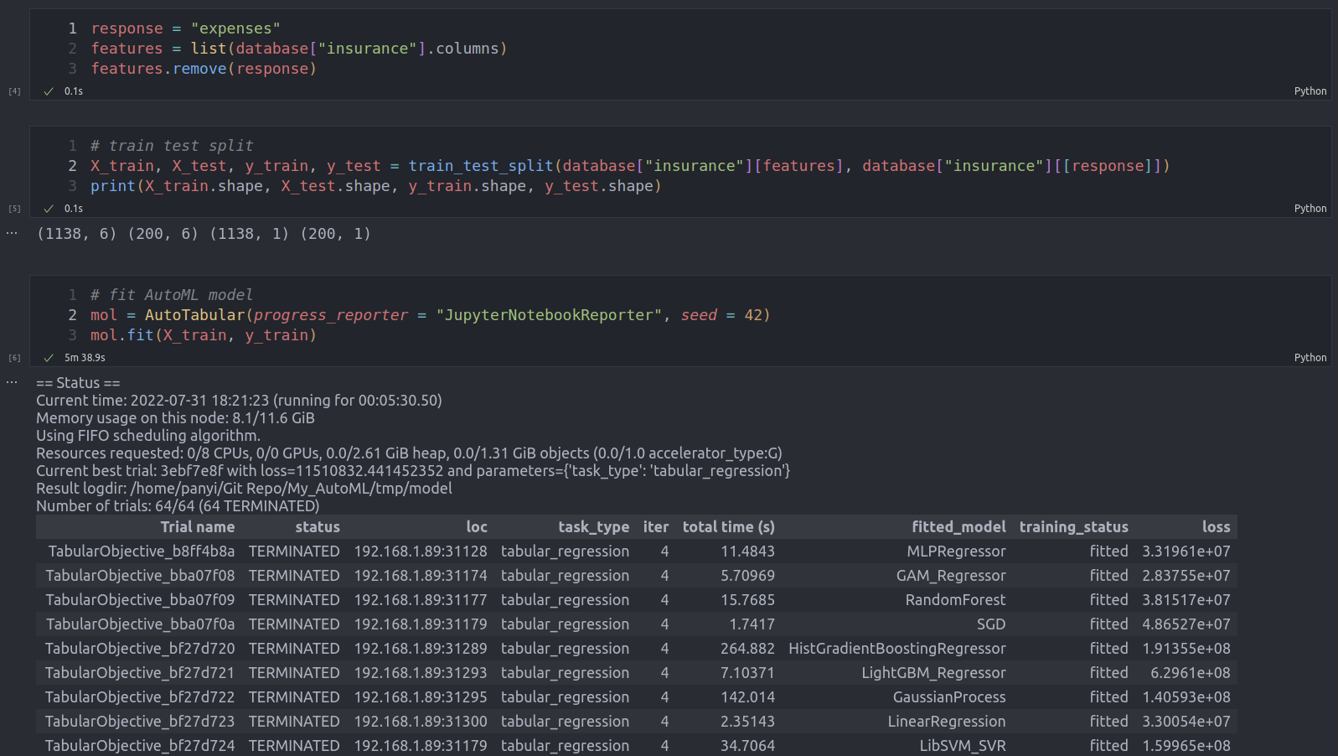
3. Experiments
3.2. Insurance Premium Prediction (Regression)
Fig. Train Test split & conduct experiment

Slide 44
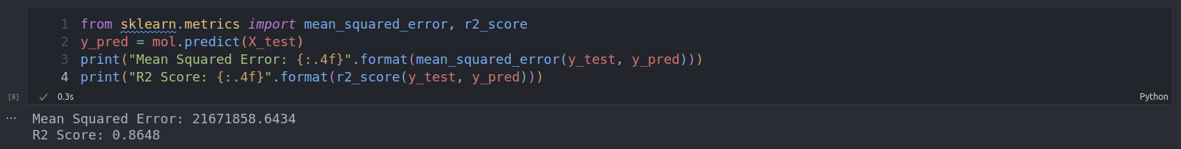
3. Experiments
3.2. Insurance Premium Prediction (Regression)
Fig. Evaluate Test Performance

Slide 45
4. Summary & Future
Summary:
(1) Provide a workable pipeline/framework for AutoML tasks.
(2) Performance and efficiency of the pipeline for small datasets are at acceptable level.
(3) For further improvement on accuracy, increase the time budget to allow more search & evaluations; or use current results as baseline to limit further search space.
Future:
(1) Modify the search space to allow faster training; Develop/Apply better search algorithm;
(2) Find an applicable Neural Architecture Search (NAS) algorithm and hyperparameter optimization algorithm to expand allowed tasks.
(3) AutoML usually is time-consuming, computational-expansive, thus, train on large datasets are not feasible, which limits its applications. Apply Few-shot, One-shot idea to improve efficiency.

Slide 46
Reference
[1] Mitchell, T. M., & Mitchell, T. M. (1997). Machine learning (Vol. 1, No. 9). New York: McGraw-hill.
[2] https://www.imeche.org/news/news-article/webinar-autonomous-vehicles---the-challenges-of-automated-driving
[3] Thornton, C., Hutter, F., Hoos, H. H., & Leyton-Brown, K. (2013, August). Auto-WEKA: Combined selection and hyperparameter optimization of classification algorithms. In Proceedings of the 19th ACM SIGKDD international conference on Knowledge discovery and data mining (pp. 847-855).
[4] https://auto.gluon.ai/stable/index.html
[5] https://automl.github.io/auto-sklearn/master/
[6] https://automl.github.io/Auto-PyTorch/development/
[7] https://github.com/hibayesian/awesome-automl-papers/blob/master/resources/automl.png
[8] Musil, C. M., Warner, C. B., Yobas, P. K., & Jones, S. L. (2002). A comparison of imputation techniques for handling missing data. Western journal of nursing research, 24(7), 815-829.
[9] Stekhoven, D. J., & Bühlmann, P. (2012). MissForest—non-parametric missing value imputation for mixed-type data. Bioinformatics, 28(1), 112-118.

Slide 47
Reference
[10] Azur, M. J., Stuart, E. A., Frangakis, C., & Leaf, P. J. (2011). Multiple imputation by chained equations: what is it and how does it work?. International journal of methods in psychiatric research, 20(1), 40-49.
[11] Yoon, J., Jordon, J., & Schaar, M. (2018, July). Gain: Missing data imputation using generative adversarial nets. In International conference on machine learning (pp. 5689-5698). PMLR.
[12] Batista, G. E., Prati, R. C., & Monard, M. C. (2004). A study of the behavior of several methods for balancing machine learning training data. ACM SIGKDD explorations newsletter, 6(1), 20-29.
[13] Tomek, I. (1976). Two modifications of CNN.
[14] https://mlwhiz.com/blog/2020/01/28/imbal/
[15] Wilson, D. L. (1972). Asymptotic properties of nearest neighbor rules using edited data. IEEE Transactions on Systems, Man, and Cybernetics, (3), 408-421.
[16] https://www.researchgate.net/figure/Wilson-Editing-for-a-1-NN-Classifier_fig1_4133603

Slide 48
Reference
[17] Hart, P. (1968). The condensed nearest neighbor rule (corresp.). IEEE transactions on information theory, 14(3), 515-516.
[18] Chawla, N. V., Bowyer, K. W., Hall, L. O., & Kegelmeyer, W. P. (2002). SMOTE: synthetic minority over-sampling technique. Journal of artificial intelligence research, 16, 321-357.
[19] https://towardsdatascience.com/stop-using-smote-to-handle-all-your-imbalanced-data-34403399d3be
[20] Chandrashekar, G., & Sahin, F. (2014). A survey on feature selection methods. Computers & Electrical Engineering, 40(1), 16-28.
[21] Somol, P., Pudil, P., Novovičová, J., & Paclık, P. (1999). Adaptive floating search methods in feature selection. Pattern recognition letters, 20(11-13), 1157-1163.
[22] Tan, F., Fu, X., Zhang, Y., & Bourgeois, A. G. (2008). A genetic algorithm-based method for feature subset selection. Soft Computing, 12(2), 111-120.
[23] Liu, Y., Tang, F., & Zeng, Z. (2014). Feature selection based on dependency margin. IEEE Transactions on Cybernetics, 45(6), 1209-1221.

Slide 49
Reference
[24] Peng, H., Long, F., & Ding, C. (2005). Feature selection based on mutual information criteria of max-dependency, max-relevance, and min-redundancy. IEEE Transactions on pattern analysis and machine intelligence, 27(8), 1226-1238.
[25] Li, Z. (2022). A Feature Selection Method Using Dynamic Dependency and Redundancy Analysis. Arabian Journal for Science and Engineering, 1-15.
[26] Lall, S., Sinha, D., Ghosh, A., Sengupta, D., & Bandyopadhyay, S. (2021). Stable feature selection using copula based mutual information. Pattern Recognition, 112, 107697.
[27] Lall, S., & Bandyopadhyay, S. (2019, September). An l1-Norm regularized copula based feature selection. In Proceedings of the 2019 3rd International Symposium on Computer Science and Intelligent Control (pp. 1-6).
[28] Hastie, T., Rosset, S., Zhu, J. & Zou, H. Multi-class adaboost. Statistics and its Interface
2, 349–360 (2009).
[29] Safavian, S. R. & Landgrebe, D. A survey of decision tree classifier methodology. IEEE
transactions on systems, man, and cybernetics 21, 660–674 (1991).

Slide 50
Reference
[30] Fan, R.-E., Chang, K.-W., Hsieh, C.-J., Wang, X.-R. & Lin, C.-J. Liblinear: A library for
large linear classification. the Journal of machine Learning research 9, 1871–1874 (2008).
[31] Chang, C.-C. & Lin, C.-J. Libsvm: a library for support vector machines. ACM transactions
on intelligent systems and technology (TIST) 2, 1–27 (2011).
[32] https://medium.com/@viveksalunkhe80/support-vector-machine-svm-88f360ff5f38
[33] Gardner, M. W. & Dorling, S. Artificial neural networks (the multilayer perceptron)—a
review of applications in the atmospheric sciences. Atmospheric environment 32, 2627–
2636 (1998).
[34] Wilhelm, F. The idea behind automatic relevance determination and bayesian interpolation.
https://www.youtube.com/watch?v=2gT-Q0NZzoE (2016).
[35] Wang, J. An intuitive tutorial to gaussian processes regression. arXiv preprint
arXiv:2009.10862 (2020).
[36] Ke, G., Meng, Q., Finley, T., Wang, T., Chen, W., Ma, W., ... & Liu, T. Y. (2017). Lightgbm: A highly efficient gradient boosting decision tree. Advances in neural information processing systems, 30.

Slide 51
Reference
[37] Chen, T., & Guestrin, C. (2016, August). Xgboost: A scalable tree boosting system. In Proceedings of the 22nd acm sigkdd international conference on knowledge discovery and data mining (pp. 785-794).
[38] Servén D., Brummitt C. (2018). pyGAM: Generalized Additive Models in Python. Zenodo. DOI: 10.5281/zenodo.1208723
[39] Pedregosa, F., Varoquaux, G., Gramfort, A., Michel, V., Thirion, B., Grisel, O., ... & Duchesnay, E. (2011). Scikit-learn: Machine learning in Python. the Journal of machine Learning research, 12, 2825-2830.
[40] Feurer, M., Klein, A., Eggensperger, K., Springenberg, J., Blum, M., & Hutter, F. (2015). Efficient and robust automated machine learning. Advances in neural information processing systems, 28.
[41] https://www.freecodecamp.org/news/how-to-use-the-tree-based-algorithm-for-machine-learning/
[42] https://online.stat.psu.edu/stat508/book/export/html/696
[43] https://towardsdatascience.com/from-linear-regression-to-ridge-regression-the-lasso-and-the-elastic-net-4eaecaf5f7e6
[44] https://towardsdatascience.com/understanding-adaboost-2f94f22d5bfe
[45] https://towardsdatascience.com/knn-visualization-in-just-13-lines-of-code-32820d72c6b6

Slide 52
Reference
[46] https://suniljangirblog.wordpress.com/2018/12/13/variants-of-gradient-descent/
[47] Liaw, R., Liang, E., Nishihara, R., Moritz, P., Gonzalez, J. E., & Stoica, I. (2018). Tune: A research platform for distributed model selection and training. arXiv preprint arXiv:1807.05118.
[48] Abadi, M., Barham, P., Chen, J., Chen, Z., Davis, A., Dean, J., ... & Zheng, X. (2016). {TensorFlow}: a system for {Large-Scale} machine learning. In 12th USENIX symposium on operating systems design and implementation (OSDI 16) (pp. 265-283).
[49] Paszke, A., Gross, S., Massa, F., Lerer, A., Bradbury, J., Chanan, G., ... & Chintala, S. (2019). Pytorch: An imperative style, high-performance deep learning library. Advances in neural information processing systems, 32.
[50] Akiba, T., Sano, S., Yanase, T., Ohta, T., & Koyama, M. (2019, July). Optuna: A next-generation hyperparameter optimization framework. In Proceedings of the 25th ACM SIGKDD international conference on knowledge discovery & data mining (pp. 2623-2631).
[51] Bergstra, J., Yamins, D., & Cox, D. D. (2013, June). Hyperopt: A python library for optimizing the hyperparameters of machine learning algorithms. In Proceedings of the 12th Python in science conference (Vol. 13, p. 20).

Slide 53
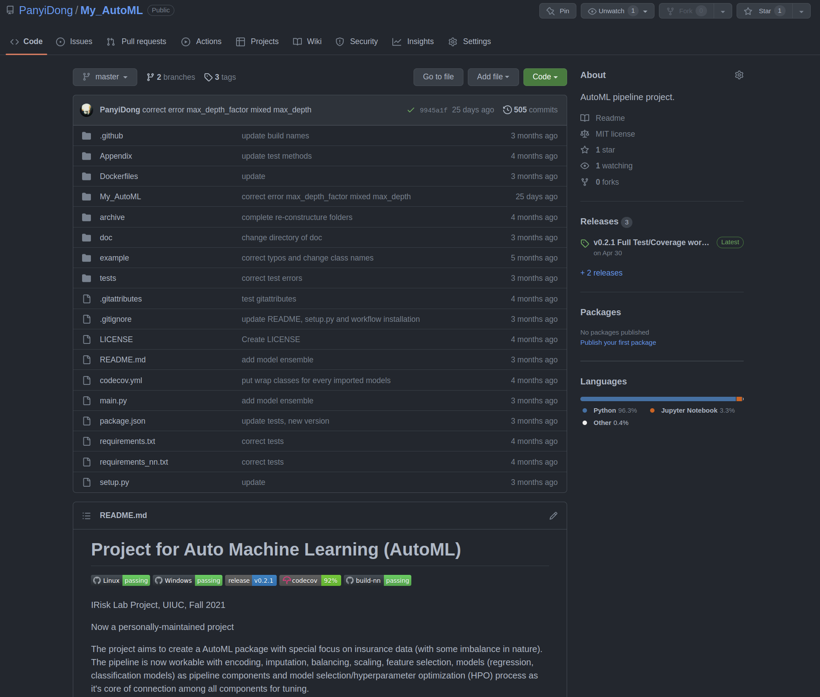
All code files, report and presentations are available at: https://github.com/PanyiDong/My_AutoML.git
Tutorials on installment, usage are all available at the page.

Slide 54
Thanks!

Slide 55
Questions

